Slide 1
Carbon storage in the geosphere
Facilitator: Dr. Steve Larter, University of Calgary
Panelists: Dr. Don Lawton, Dr. Sean McCoy, Dr. Stuart Haszeldine,Candice Paton, and Patrick Elliott
Date: September 23, 2021
Time: 8 a.m. MT

Slide 2
Carbon storage in the geosphere – CCS 2.0
Carbon Capture and Storage (CCS) is an evolving and growing suite of technologies that has been used in one form or another for 50 years and forms a key component of climate change mitigation strategies.
While several of the technologies have been proven at commercial pilot scale, a large-scale CCS industry has not yet been developed. However, that situation is now changing with the emergence of both an expanding industrial and technology development base, enhanced investor and innovation community interest, and firmer government commitments to climate targets.
This increased interest has driven both academic and business interest in research, technology development and implementation, both to validate climate mitigation impacts and reduce costs, to accelerate widespread adoption and crucially to develop and evaluate new technologies in the broader area of large-scale carbon dioxide removal from the atmosphere (CDR) and negative emissions.
We’ll examine the drive toward cluster collection, transport and storage systems, CCS as a business opportunity, explore the link between hydrogen production and CCS and also examine the present and likely future states of large-scale carbon dioxide removal systems.
This webinar features a panel of experts drawn from a cross-section of business and academic sectors in Canada and the UK to discuss current trends and possible future states for carbon capture and storage in the geosphere.

Slide 3

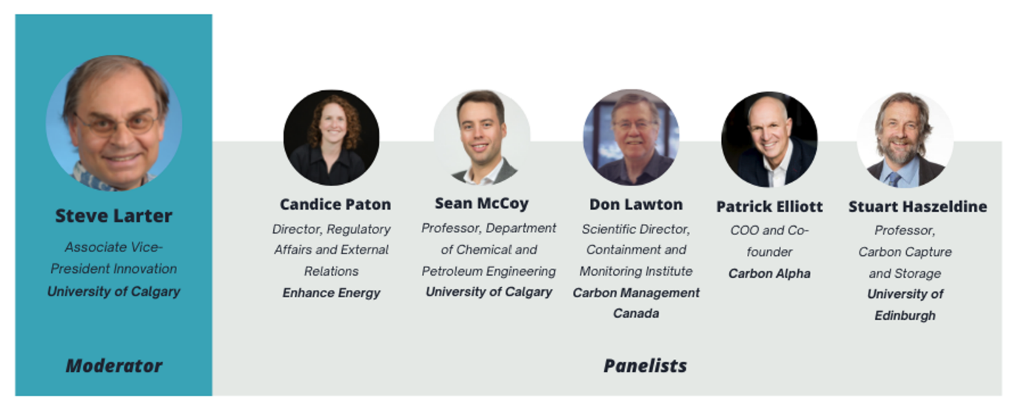





Carbon storage in the geosphere – Webinar
Thursday, Sept. 23, 2021. 8 to 9:30 am MT
Webinar coordinators: Ruth Klinkhammer(CMC); Alina Cox(UoC)
Each panelist will present two scene setting slides - 25 minutes.
Moderator leads panelists through a 45 minute discussion organized in 3 X 15 minute sections focussing on three topic areas.
15 minute Q&A with audience Steve Larter(slarter@ucalgary.ca)

Slide 4
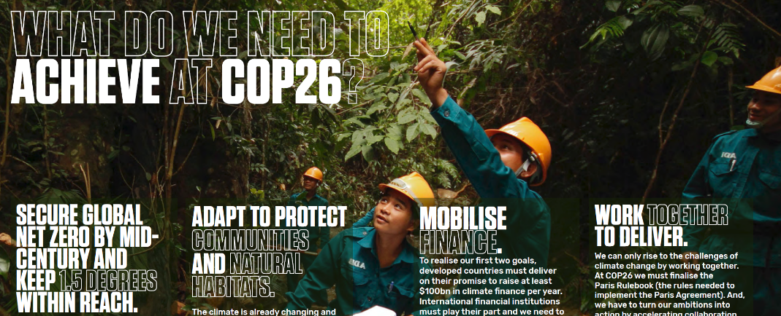



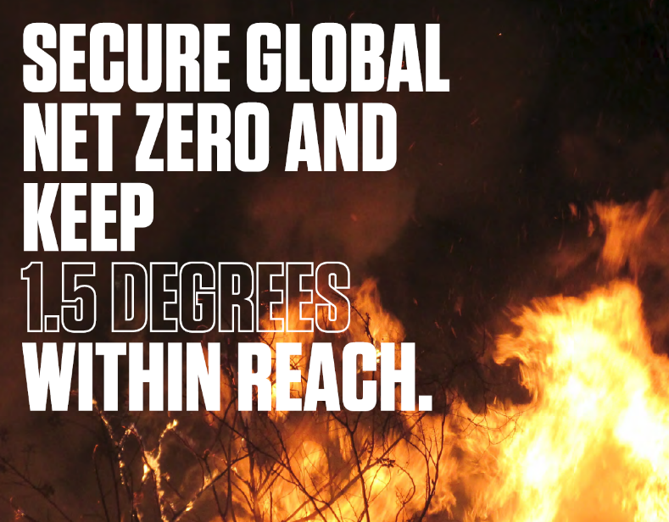
Goals: Terminology:
The world needs to halve emissions over the next decade and reach NET ZERO carbon emissions by the middle of the century if we are to limit global temperature rises to 1.5 degrees.
Carbon Capture and Storage(CCS) is one of many tools to help achieve that goal
CCS 1.0 –the original model: Large emitters such as powerplants or refineries have their CO2 captured and transported for safe storage in a dedicated, monitored, subsurface reservoir.
CCS 2.0- the evolving model-scaleing: CO2 captured from several locations is transported through a hub and pipeline system to dedicated storage reservoirs onshore or offshore
Carbon Dioxide Removal(CDR): To achieve NET ZERO, it is not enough to just capture and store our current emissions. By end of century we must also remove large amounts of CO2 from the atmosphere using CDR and safely store the carbon. These techniques can involve air capture(DAC, BECCS), ocean capture, or use weathering of rocks or land management to remove and safely store carbon through a variety of storage routes.
https://ukcop26.org/cop26-goals/

Slide 5
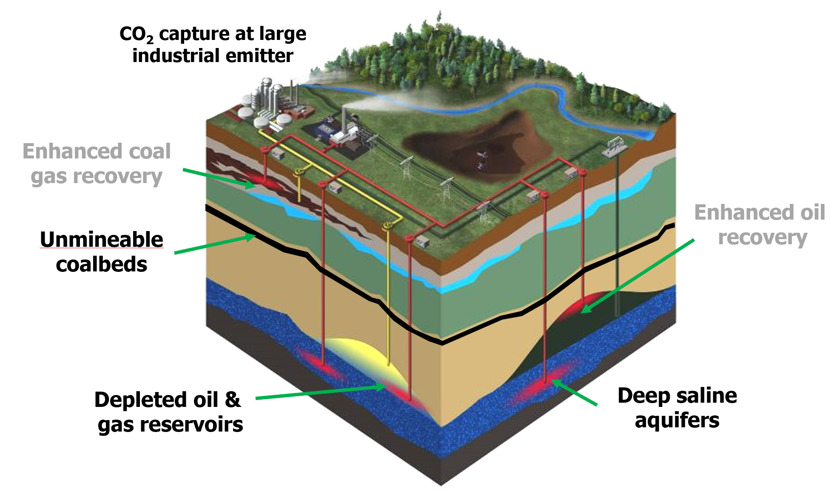
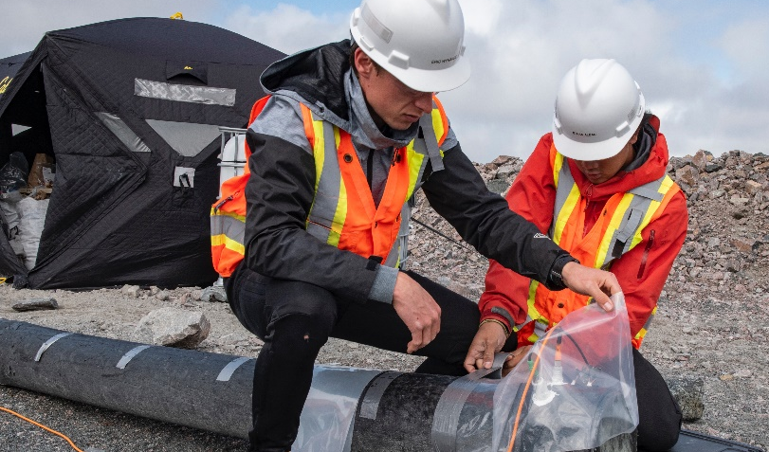
Carbon capture and storage (CCS)
Sedimentary basins
Storage in depleted hydrocarbon reservoirs
Geometry of reservoir is known
Physical trapping mechanism
Known caprock integrity
Production is history-matched
Potential for leakage through legacy wells
Storage in saline formations
Reservoir may not be confined
Chemical/hydrodynamic trapping mechanism
Caprock integrity untested
No history to match
Few wells that penetrate reservoir
Mine tailings
(mineralization)
Courtesy Greg Dipple, UBC
don.lawton@cmcghg.com

Slide 6
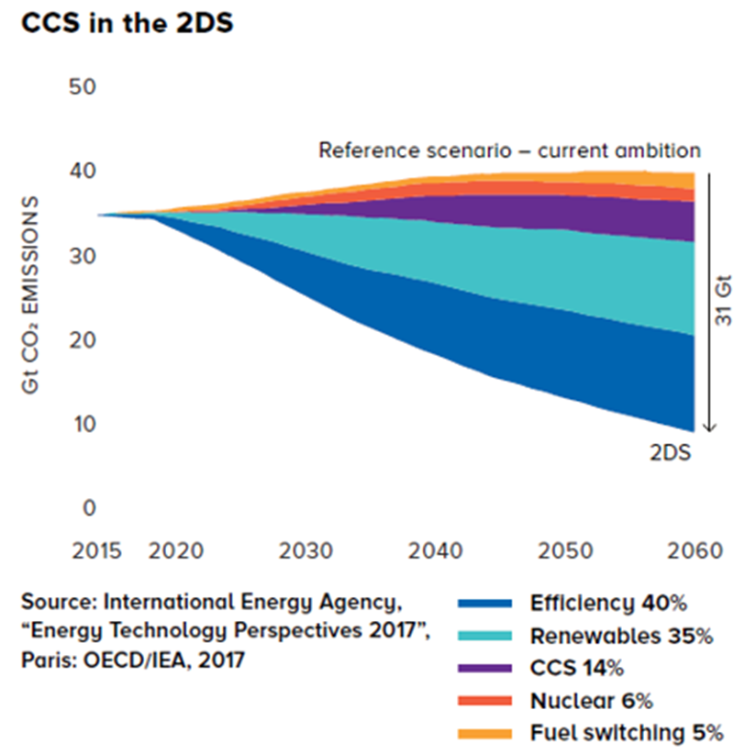
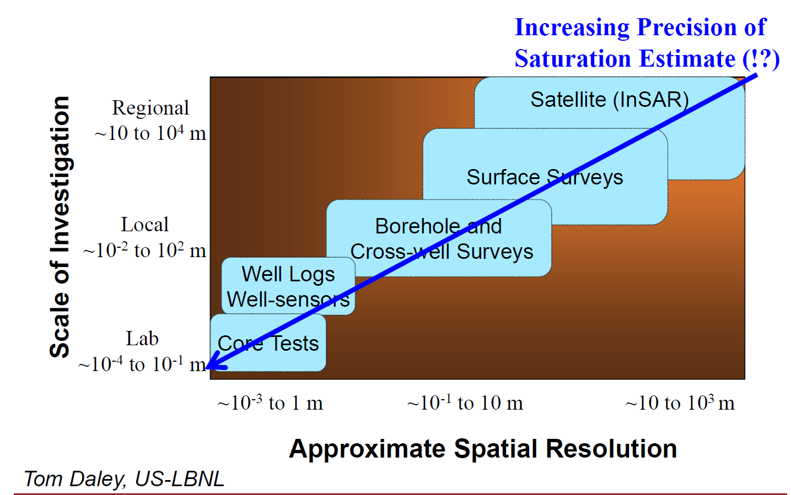
Monitoring for gigatonne-scale CCS hubs
CCS: 5 Gt/yr by 2050
Require monitoring and closure plans to be based on a project-specific risk assessment, and include the use of best available technologies to monitor the atmosphere, surface, ground and surface water, and subsurface.
Alberta CCS Regulatory Framework Assessment
Requirements: Regional characterization and baselines, containment, conformance, interference, closure and post-closure liability
don.lawton@cmcghg.com

Slide 7







Momentum for significant global climate action is building rapidly
With over 100 countries committed to ‘net-zero emissions’ before 2050, we can expect to see continued and rapid strengthening of policymaking
  Close to 300 major global companies (and rising weekly) have made net-zero-before-2050 pledges
Quest CCS actual project cost
  Sustainability is the new disruptor with consumers demanding action from suppliers of goods and services
Estimate if Quest CCS built today
  Technology advances and infrastructure investment have shifted the cost curve down, while powerful new technologies are enabling solutions to be optimized and scaled
  Investors representing over US$45 trillion of assets under management have signed on to drive action on climate change across their portfolios¹
Patrick Elliott (pelliott@carbonalpha.com)

Slide 8
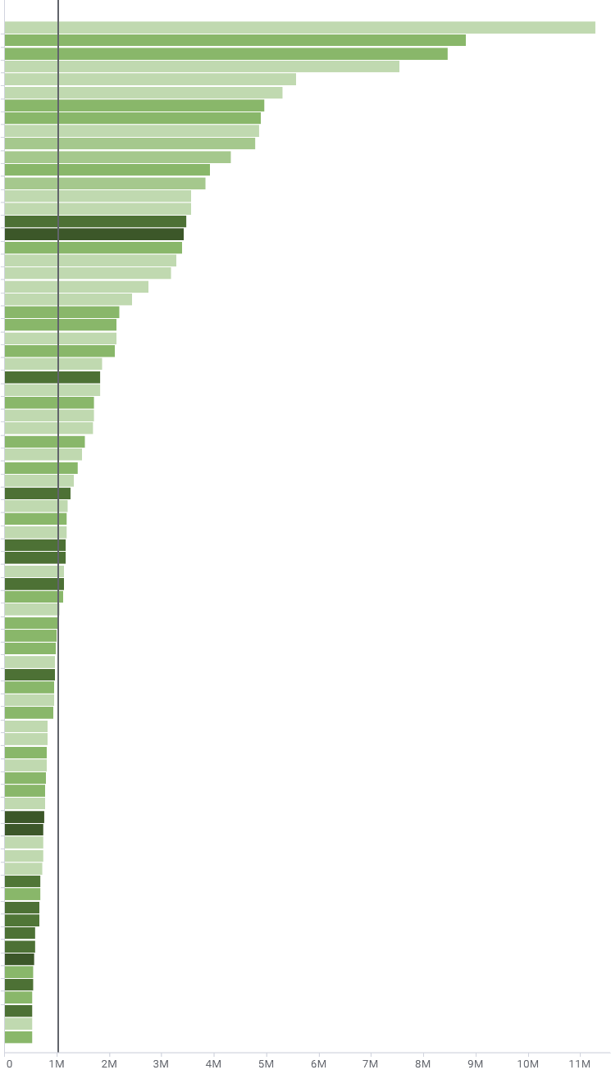
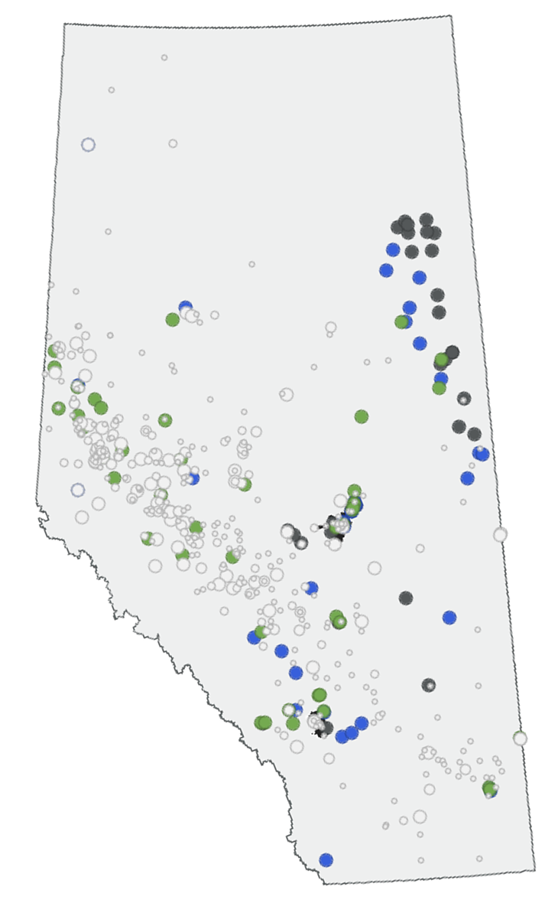









Canada can meet the CCS challenge – Alberta set to lead
Emissions by facility (AB, SK, ON)
Alberta
695 registered emitters across Alberta
Highest concentration of national emissions
Endowment of world-class distributed storage capacity
216 Mtpa CO₂ reported as all facility emissions from Alberta, Saskatchewan and Ontario
Subsurface data from the legacy of the petroleum industry lowers risk and improves decision making
List of facilities >0.5 Mtpa
180 Quest-sized projects across Alberta, Saskatchewan and Ontario requiring
~$150 billion
of investment
Edmonton
Pore space for carbon injection and storage is regulated by the Alberta government and is distinct and separate from oil and gas mineral rights; a significant advantage over most jurisdictions
Services, expertise and equipment is readily available for industrial projects
Calgary
World-class CCS projects in Quest, Alberta Carbon Trunk Line (ACTL) and Boundary Dam / Aquistore provide annual public project reporting, a condition of government funding
Shell Quest project 1.2 Mtpa
Quest
1.2 Mtpa sequestered > 5 Mt to date is a leading global facility providing local knowledge and operating parameters
ACTL
Dedicated 14.6 Mtpa CO₂ transportation pipeline spanning 240 km, initiated in June 2020

Slide 9
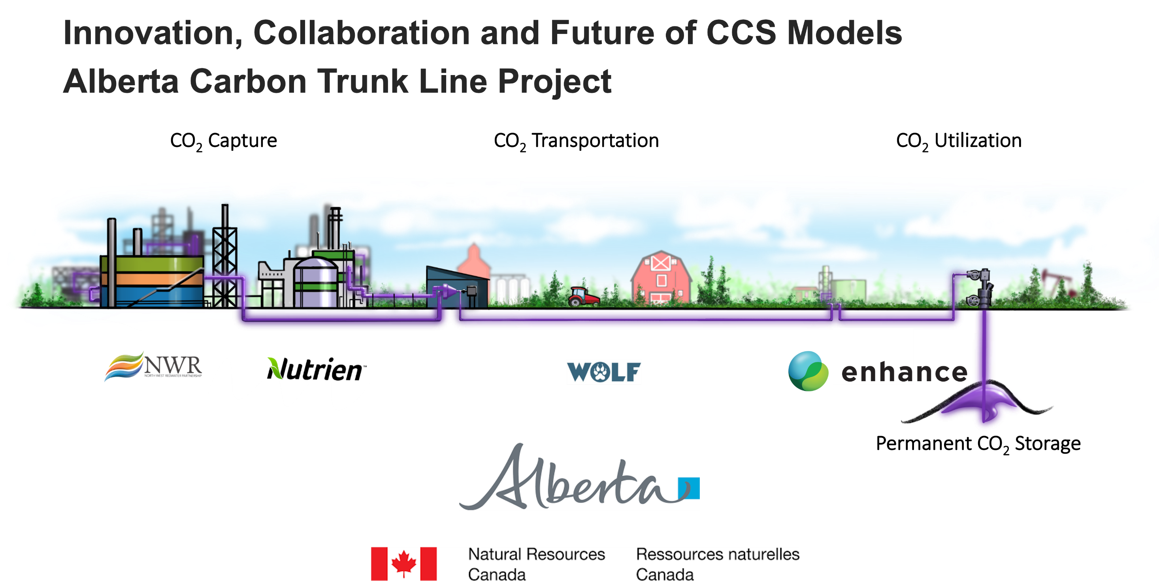
Candice Paton (cpaton@enhanceenergy.com

Slide 10
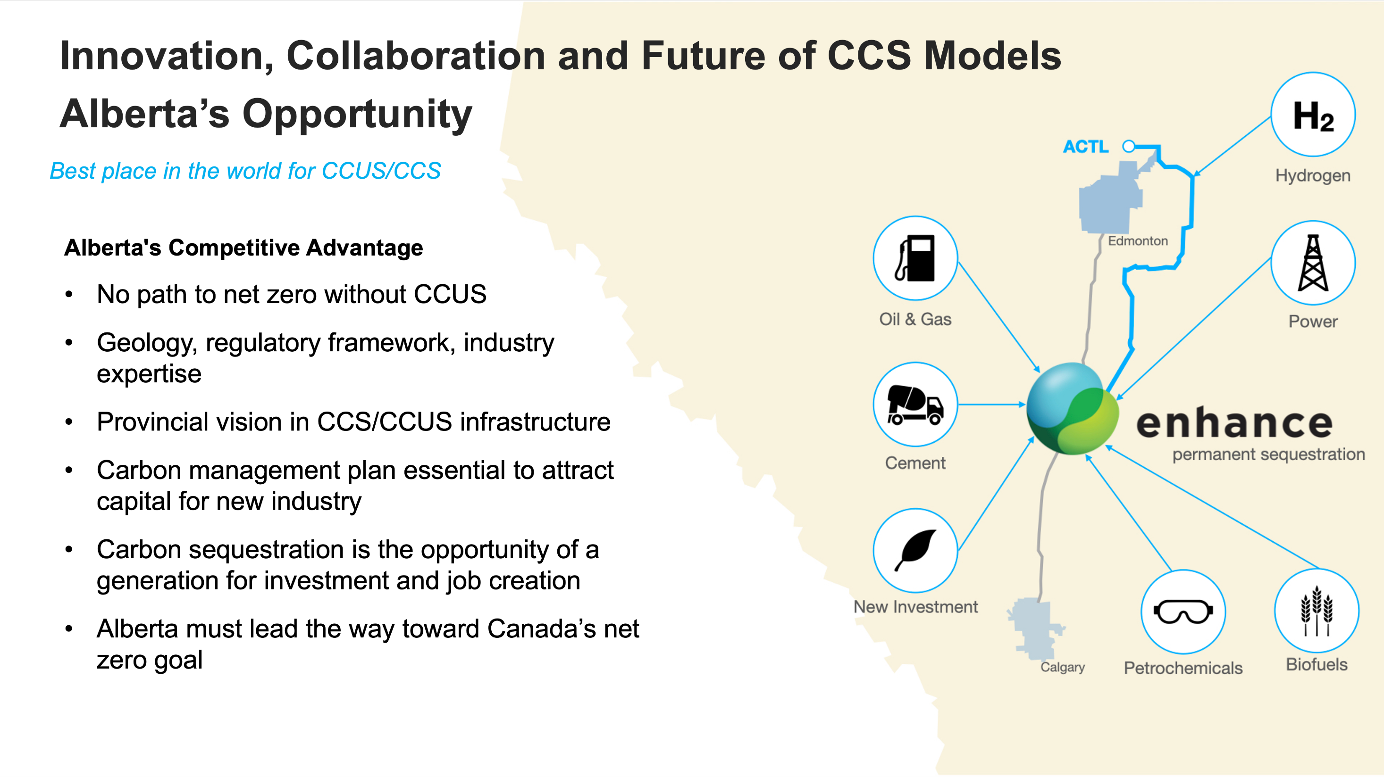

Slide 11
CCS and CDR: Why, when, and how?
Anticipated UK storage/year required 2050
400 Mt CO2/yr 2021
140 MtCO2/yr 2050
aviation
Non CO2
Greenhouse Gas Removal, Royal Society and Royal Academy of Engineering, 2017
NET methods
Industry
Transport
Heat
Power
Greenhouse Gas Removal, Royal Society and Royal Academy of Engineering, 2017

Slide 12
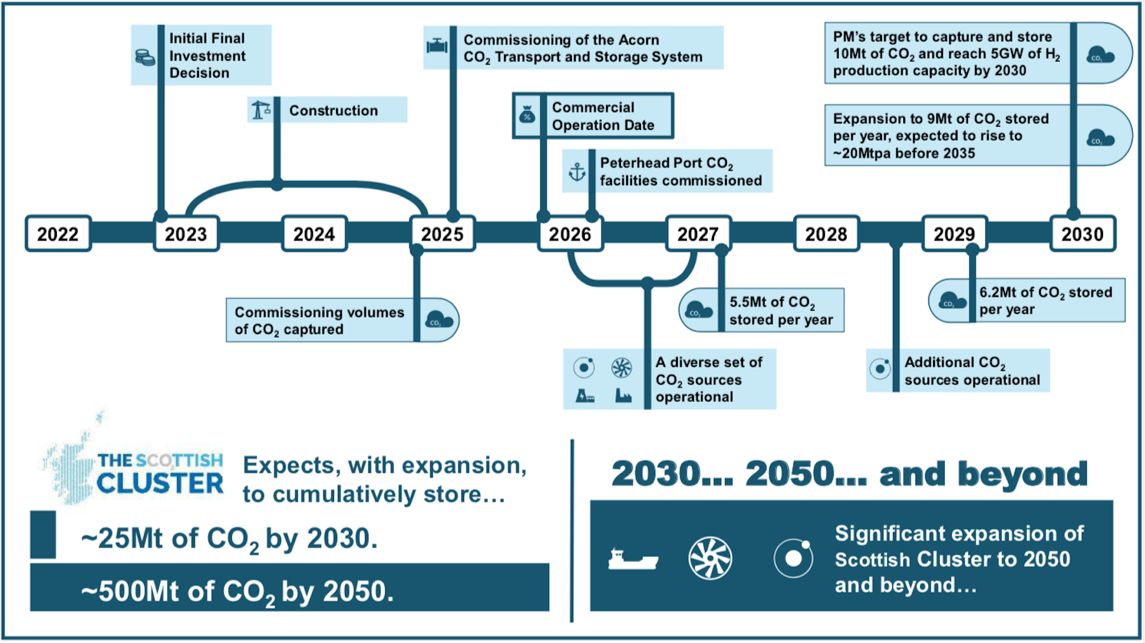
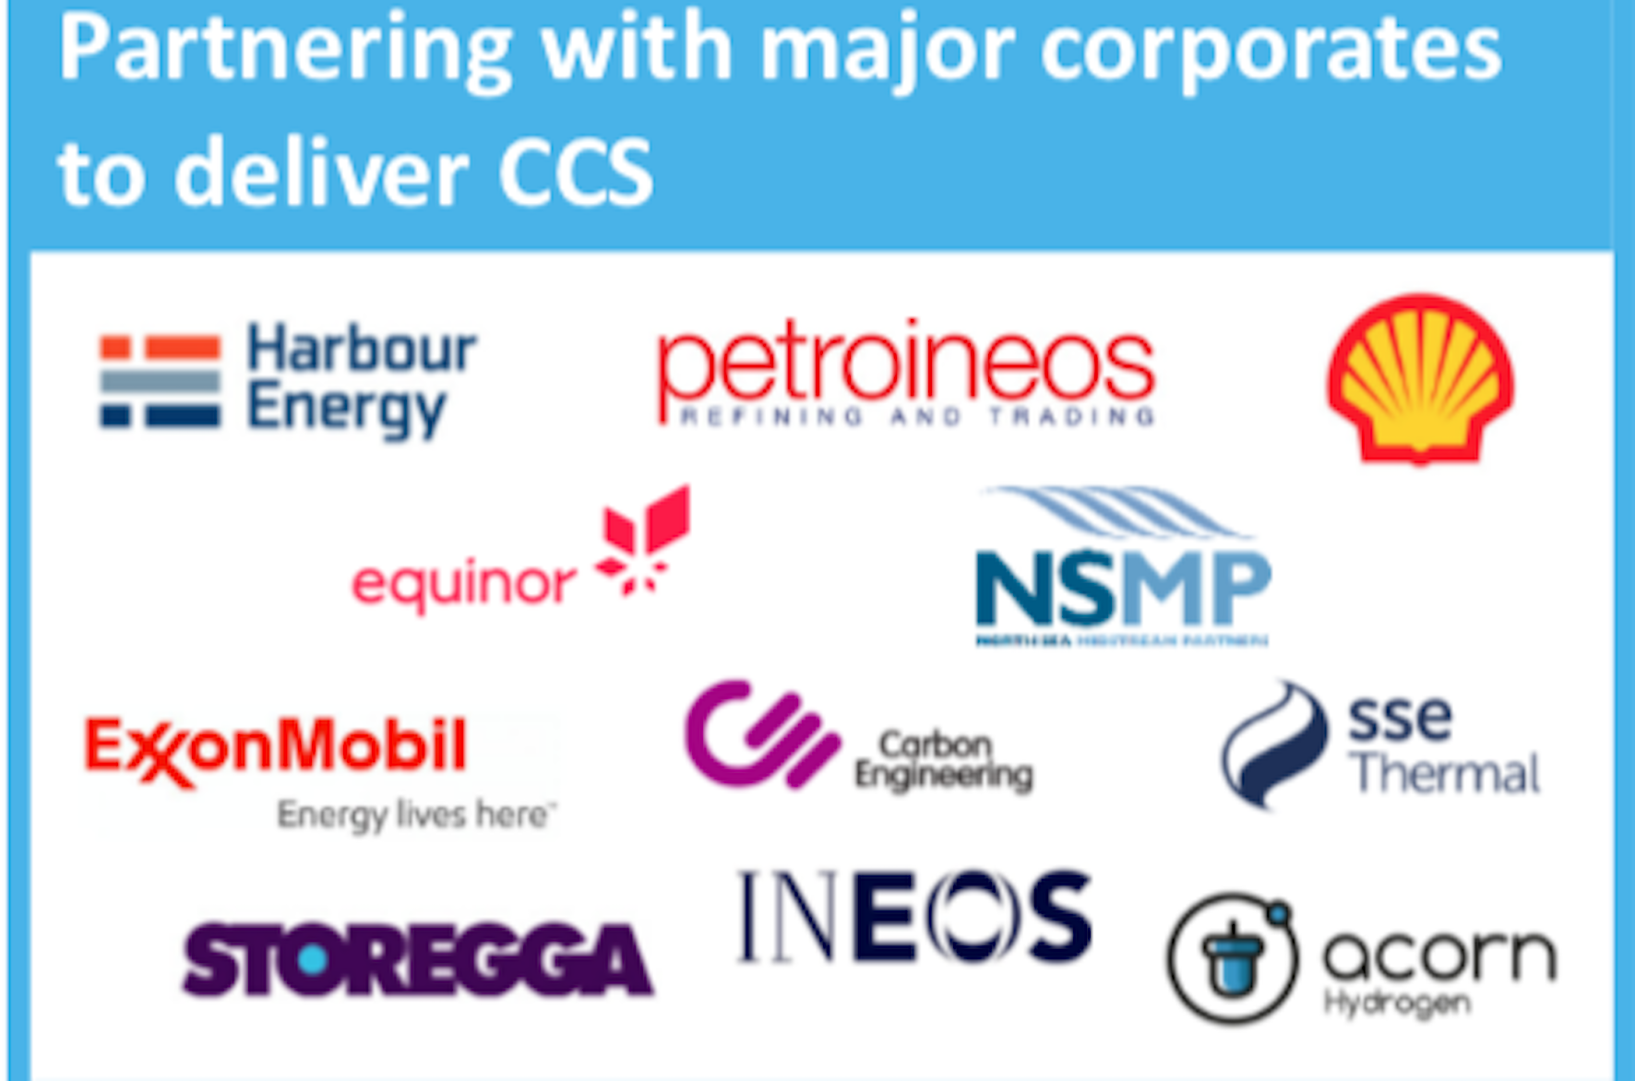
Acorn CCS cluster, Scotland
CCS since 2005

Slide 13


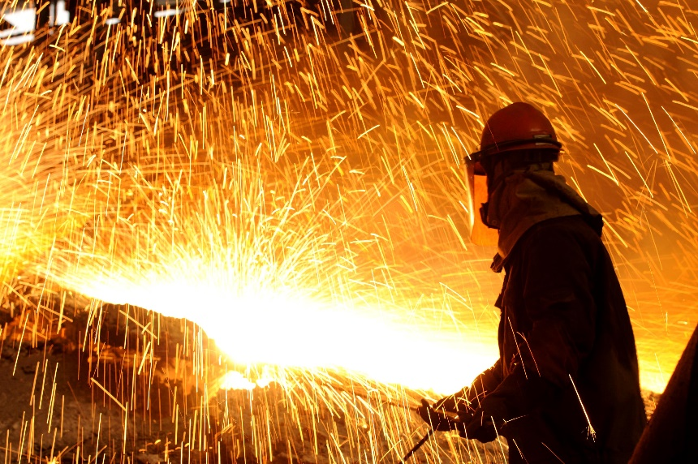
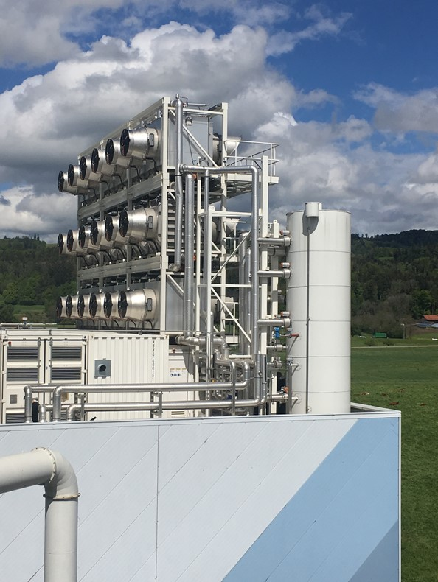
What’s needed from R&D?
Scaling, scaling, scaling
Today, a million tons per year over life of a project; tomorrow, 100’s of millions of tons per year sustained for many decades in the same sedimentary basin
CCS into industry
Primary application of CCS in many countries will be cement, iron & steel, chemicals, etc. not power generation
CCS for carbon dioxide removal
Bioenergy with CCS, direct air capture, etc. needed in addition to industrial applications
New technologies for new energy systems
Pressure to decarbonize, decline in fossil demand could lead to a system transition
Notes:
Technical to predict and mange interactions; corresponding regulatory approaches that minimize commercial risk
Great diversity of the options for capture in industrial facilities, many different ways they can be integrated in new and retrofit. So, what makes sense for retrofit applications is very much site specific. Possibly new options for industrial processes with CCS integration (e.g., Ca-L or “direct separation” in cement, DRI+EAF)
BECCS can be part of biomaterial (not just bioenergy) systems, and this is under investigated; DAC is energetically expensive, but separations involved are subject to very different constraints and there isn’t an obvious reason that the efficiency of such separations could be relatively high – much more to do here.
What is the new role for CCS in net-zero systems? Is it CCS for blue H2? CCU for carbon-neutral hydrocarbons or a “methanol” economy? There are many R&D needs in these spaces.

Slide 14
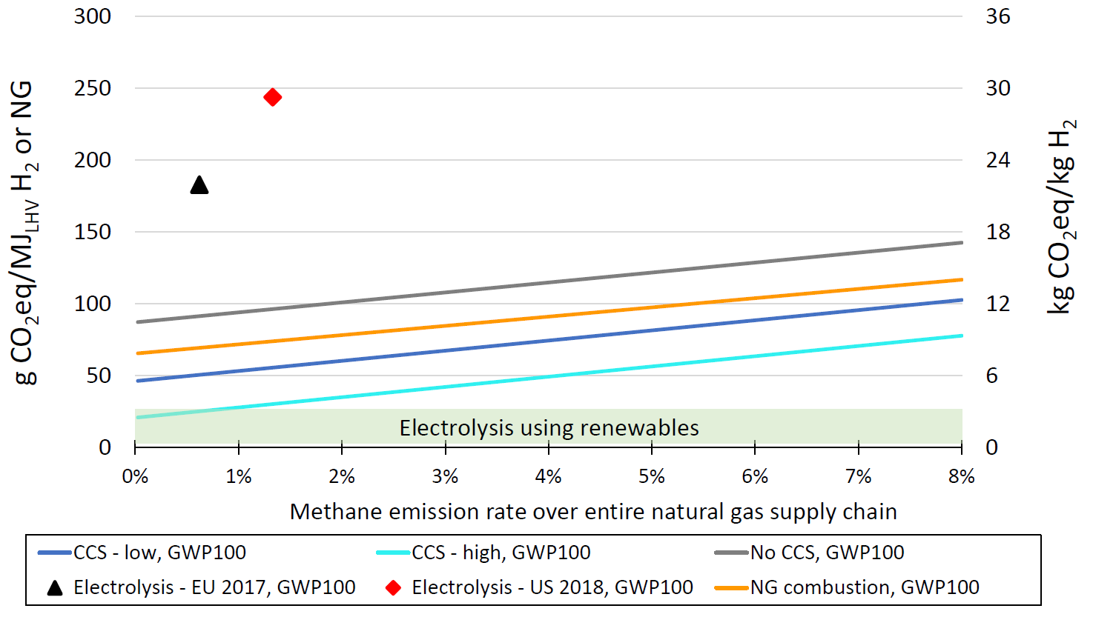
Sustainability is measured in economic, environmental and social terms
Life cycle assessment (LCA) is a framework and decision support tool; emerging application is for policy implementation
If we care about net-zero, we need to include emissions from cradle-to-grave
Complex applications: CO₂-EOR, conversion of CO₂ to products, blue hydrogen (at right)
For blue hydrogen, LCA shows that must look upstream at natural gas supply
Bauer et al. (2021)
Notes:
LCA doesn’t give absolute answers, it all depends on the questions being asked. It is also being increasingly used as part of policy instruments (e.g., California LCFS, CFS)
When we’re asking questions about environmental sustainability in a net-zero context, we need to think from cradle-to-grave
Doing an LCA right is complex, and can provide insights about where we ought to focus
For blue H2, a recent paper concluded “use of blue hydrogen appears difficult to justify on climate grounds” but did so by making largely worst-case (and some unrealistic) assumptions; several of us have repeated the analysis and have shown that it is entirely possible to have blue hydrogen that brings a climate benefit (relative to natural gas and electrolysis) but that we do need to focus on the upstream.

Slide 15
Discussion Themes

Slide 16
THEMES DISCUSSED
CCS 1.0 with linked single source and storage sites, did not take off for a variety of reasons. What is different about CCS 2.0 in terms of concept, scale and ambition in technology and the political and business environments? How important is the move toward cluster collection, transport and storage systems and is it happening quickly enough? How do onshore and offshore storage opportunities differ? What can Canada learn from Europe and elsewhere and what can Europe learn from Canada?
What is net zero and why is CDR needed? Carbon dioxide removal (CDR), technologies are a diverse suite of approaches in a very early stage of development, with few pilots at any significant scale and poorly developed research, technology development and business models. What are BECCS and DAC. Many schemes have major governance and regulation issues beyond technical challenges. What are the drivers influencing development of these approaches and what are the present and possible future states of large-scale carbon dioxide removal systems? How might they link with more traditional and conventional CCS approaches”.
It appears that CCS is an enabling technology!: There is much discussion about linkage between a more hydrogen focused energy system and CCS. Blue hydrogen, linking two major greenhouse gases-methane and carbon dioxide, is usually part of that discussion. What are the technological, and business challenges and needs in this space and what are the total GHG emissions realities of blue hydrogen with CCS?

